Slide 1
Project A
Cohen Ellis, Nathan Gaar, David Mueller

Slide 2
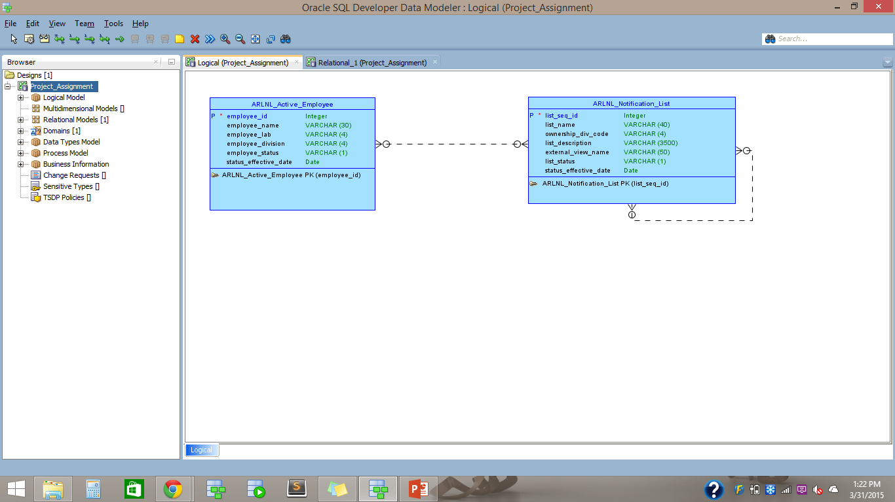
Conceptual Model

Slide 3
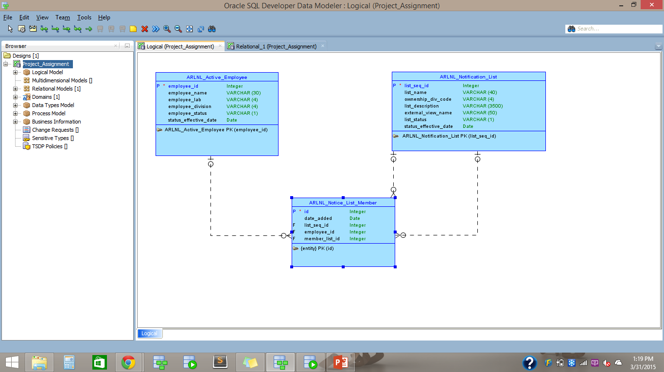
Logical Model

Slide 4
Questions
Is the Lab/Division one to one or one to many for Active Employees?
When implementing the must haves, we thought, in respect to having downloadable files, it might be best to ask the customer where they would prefer to have this feature implemented?
Are the first and last name sections separate?
Are we in charge of taking care of inactive lists or members?
How much authority do we have in using the given employee table?

Slide 5
Steps to implement Must Haves/Good Haves
We went through all of the pages of the must haves to make sure that we understand how to implement the features.
After creating our conceptual and logical models, we decided to implement good to haves that concentrate on safe submission of the forms.
We also wanted to make the project look like the suggested template.
These included a timer for the dialogs, and theme roller for the layout.

